Slide 1
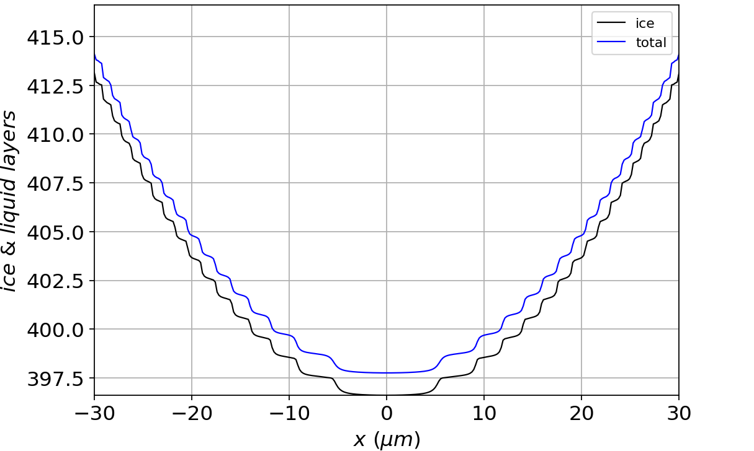
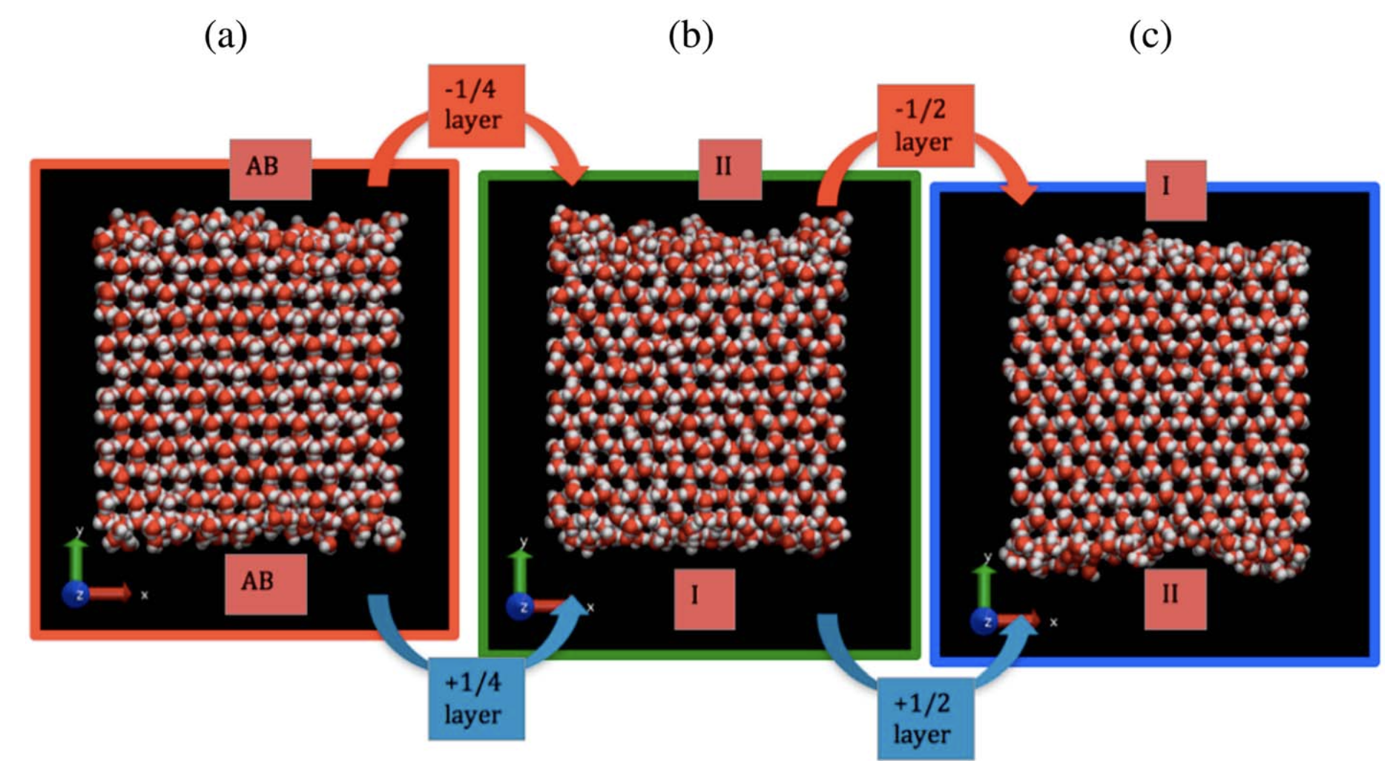
“Risers” correspond to mainly $μ$surface I (thin QLL)

Slide 2
“Treads” correspond to mainly $μ$surface II (thick QLL)

Slide 3
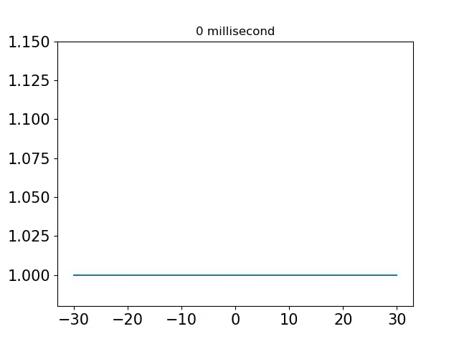

$N_{QLL}$ evolves to a stable limit cycle
$$N_{QLL}$$

Slide 4
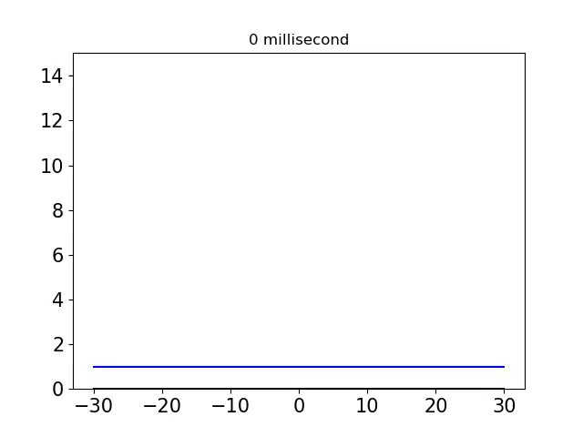

The total ice thickness evolves to a stable traveling wave
$$N_{tot}=N_{ice}+N_{QLL}$$

Slide 5
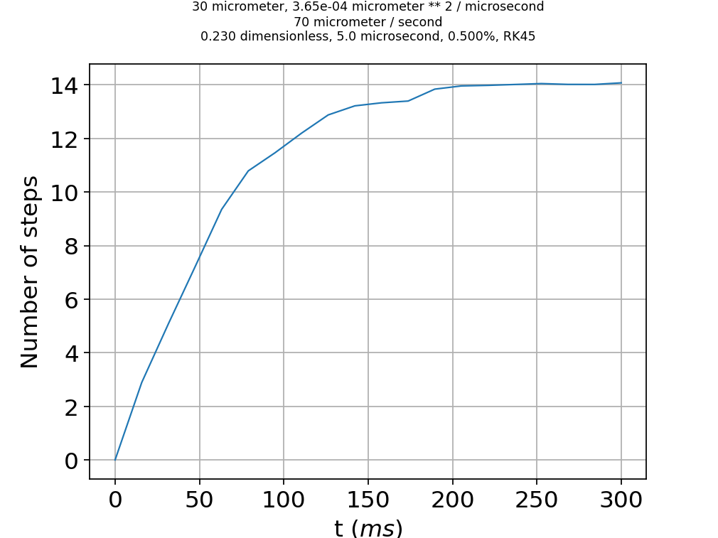
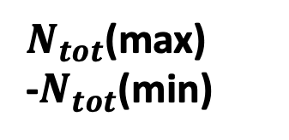



Time reach these limit cycles/traveling waves
$$N_{tot}$$
$N_{tot}$(max)
-$N_{tot}$(min)
Limit cycle/converged traveling wave achieved after $\sim 200 ms$
$$N_{QLL}$$

